Slide 1
COE 510 Programming Methods for Robotics
An integrated UGV-UAV system for Crowd Control
Final Presentation
By: Yousef Ali and Ibrahim Al-Jalal
26 / 12 / 2020

Slide 2
Outline
Introduction
Problem Statement
Proposed Solution
Related Work
Proposed Solution (Crowd Detection)
System Design
System Prototype
Discussion
Conclusion and Future work

Slide 3
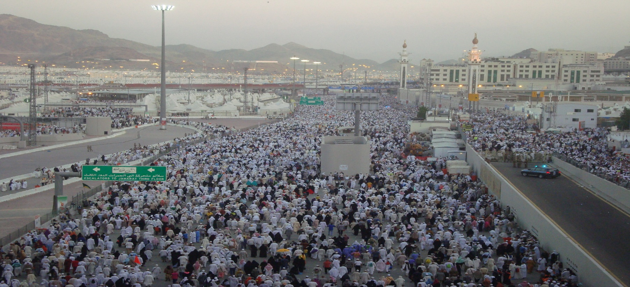
Introduction
Need to monitor crowd and environment in large gatherings.
System to achieve the same must be scalable, portable and require minimal configuration.

Slide 4
Problem Statement
UAVs
Pros; Wider area and a global view of the crowd.
Cons; Lack accuracy for many factors such as the speed and altitude limits, on-board sensor resolution, and environmental disturbances.
UGVs
Pros: Accurate sensing capability.
Cons: Observation range is smaller- obstructed by nearby obstacles.

Slide 5
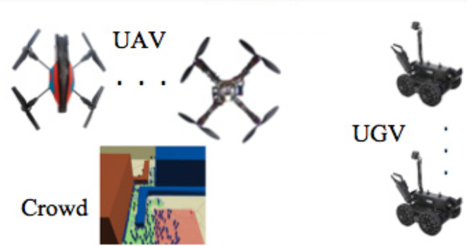
Proposed Solution
UGVs can observe dynamic movements of individual agents in a sub-crowd within their observation range, with high resolution.
UAVs can provide global but less accurate information on the overall dynamic movement of the crowd.
By integrating the information from both UGVs and UAVs , the dynamics of the crowd region at future time can be better estimated.

Slide 6
Related Work
No. | Year | Title | Contribution | Tools
[1] | 2013 | A DDDAMS-based planning and control framework for surveillance and crowd control via UAVs and UGVs | (1) crowd detection (vision algorithm), (2) crowd tracking (filtering), (3) UAV/UGV motion planning (graph search algorithm) | Own developed simulation framework
[2] | 2015 | Crowd detection and localization using a team of cooperative UAV/UGVs | One UAV multiple UGVs A modified moving object detection algorithm A new collaborative localization method | Real UAVs custom-build quadrotor helicopter as a UAV, and a 1/16-scale remote control car as a UGV
[3] | 2017 | UAV-based IoT platform: A crowd surveillance use case | Mobile edge computing on UAVs. Face recognition | Real hexacopter equipped with an LTE modem, a high-resolution digital camera, several computing and sensing resources.

Slide 7
Related Work
No. | Year | Title | Contribution | Tools
[4] | 2018 | When mobile crowd sensing meets UAV: Energy-efficient task assignment and route planning | Task assignment Route planning for UAVs | Dynamic programming Simulation of numerical model
[5] | 2019 | Multi-UAV based crowd monitoring system | Monitor group of moving walking individuals Assign a UAV for each individual. | Own developed simulator that can mimic the behavior of the 3DR Iris+ quadcopter and individuals’ movement.
[6] | 2019 | UAV-GCS Centralized Data-Oriented Communication Architecture for Crowd Surveillance Applications | Propose data-oriented communication architecture: Multi-UAV coordination Efficient bandwidth sharing according to data priority and urgency Avoiding useless transmission of the same data by multiple UAVs. | Matlab / Simulink

Slide 8
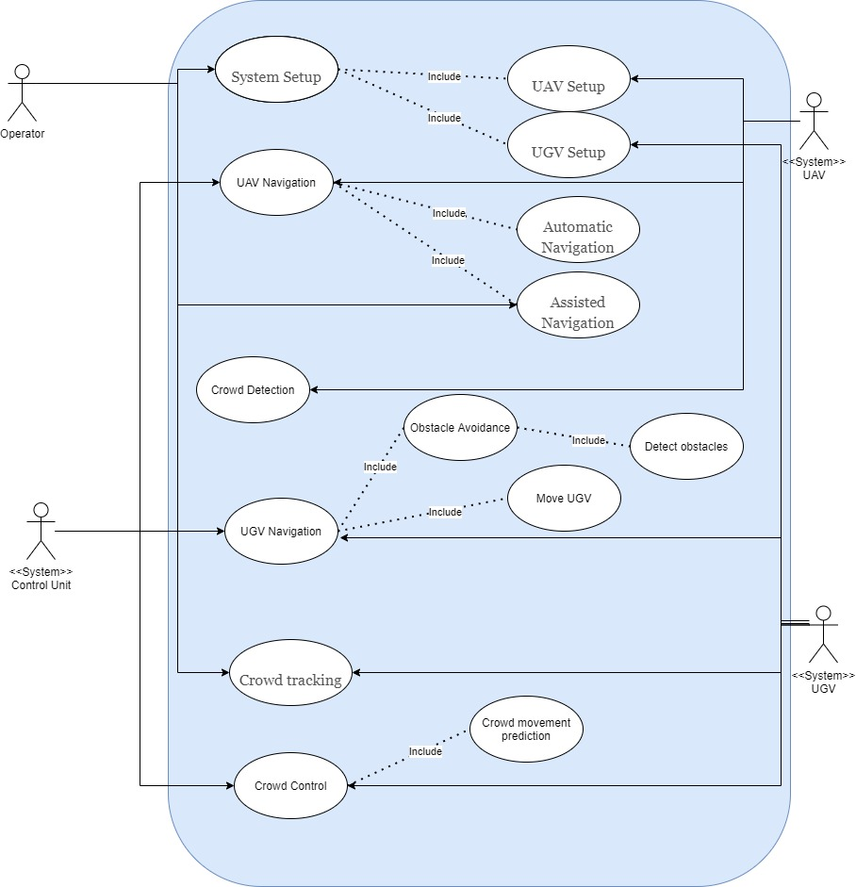
System Design

Slide 9
Implementation Tools
Simulation Environment: Gazebo simulation is used to build the simulation environment.
UGV Robot: TurtleBot3 is used to simulate the ground robots since it is compatible with Gazebo and it has many built-in sensors that can be used in the path planning and navigation.
UAV Robot: Hector Quadrotor is used to simulate the UAV.

Slide 10
Crowd Detection

Slide 11
Solution
multiple robots will communicate with drones to know if there are humans in the area who need services or gathering control and will go and provide their assistance. For simplicity we will assume that the people who want a certain service will wear a unique color (blue color) to be identified from the drone normal camera. Also, the drone will have an infrared camera sensor to see wither there are human in the area (red color). If there is a lot of red color detected in one place, this means that there is a lot of gathering in a small place which could be dangerous, so the drone will send the coordinates to the robots and police officers to manage the crowed.

Slide 12

Approach
Detected
(1,5)
(2,5)
(3,5)
(4,5)
(5,5)
(1,4)
(2,4)
(3,4)
(4,4)
(5,4)
Detected
Detected
Detected
Detected
(1,3)
(2,3)
(3,3)
(4,3)
(5,3)
Detected
(1,2)
(2,2)
(3,2)
(4,2)
(5,2)
Detected
Detected
y+
(1,1)
(2,1)
(3,1)
(4,1)
(5,1)
x+
Results:
["Blue",[(3,2),(1,5)]]
["Red",[(1,1),(5,3),(2,4)]]
["Motion",[(5,1),(1,3),[2,3]]

Slide 13
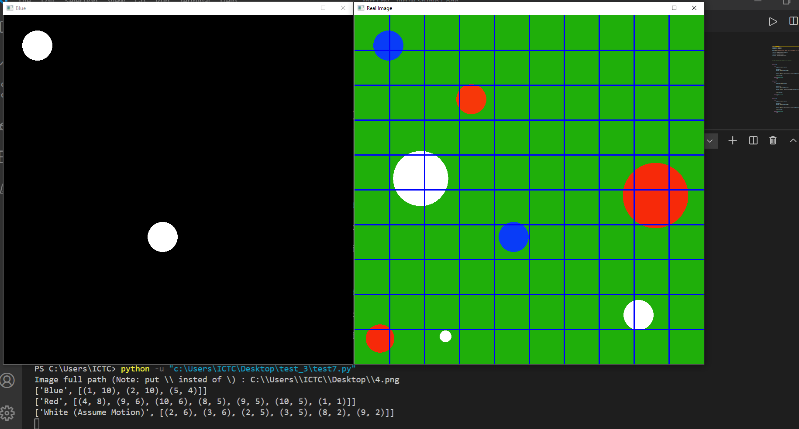
Actual Results
Motion detection blue color

Slide 14
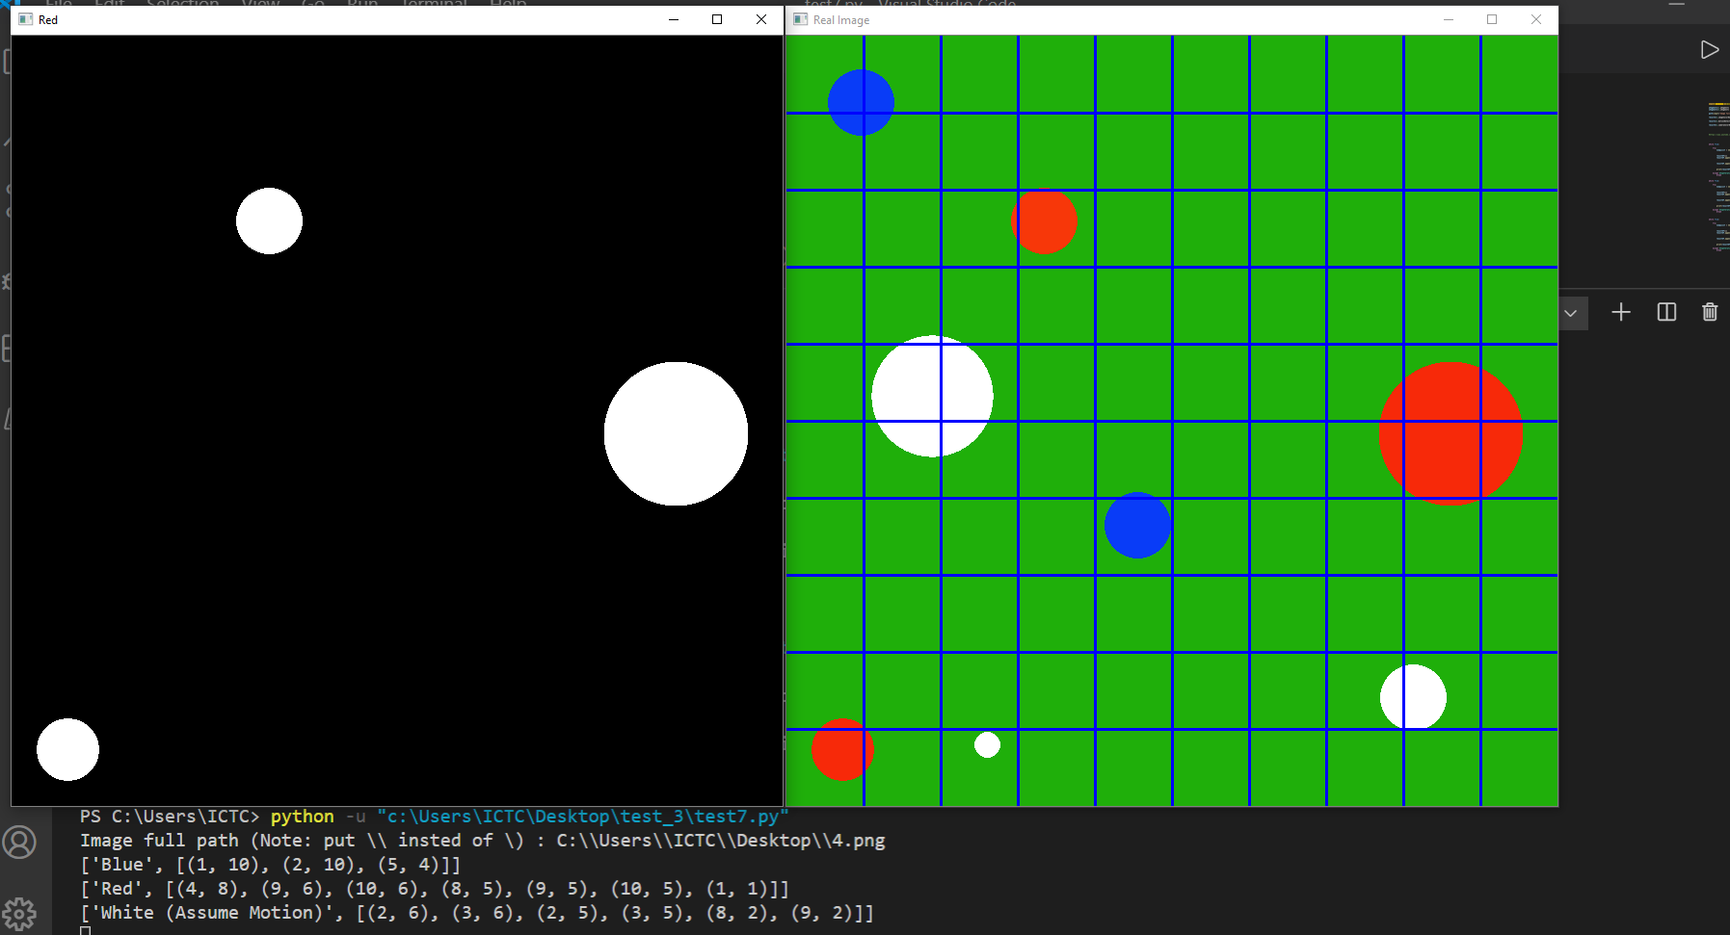
Actual Results
Motion detection red color

Slide 15
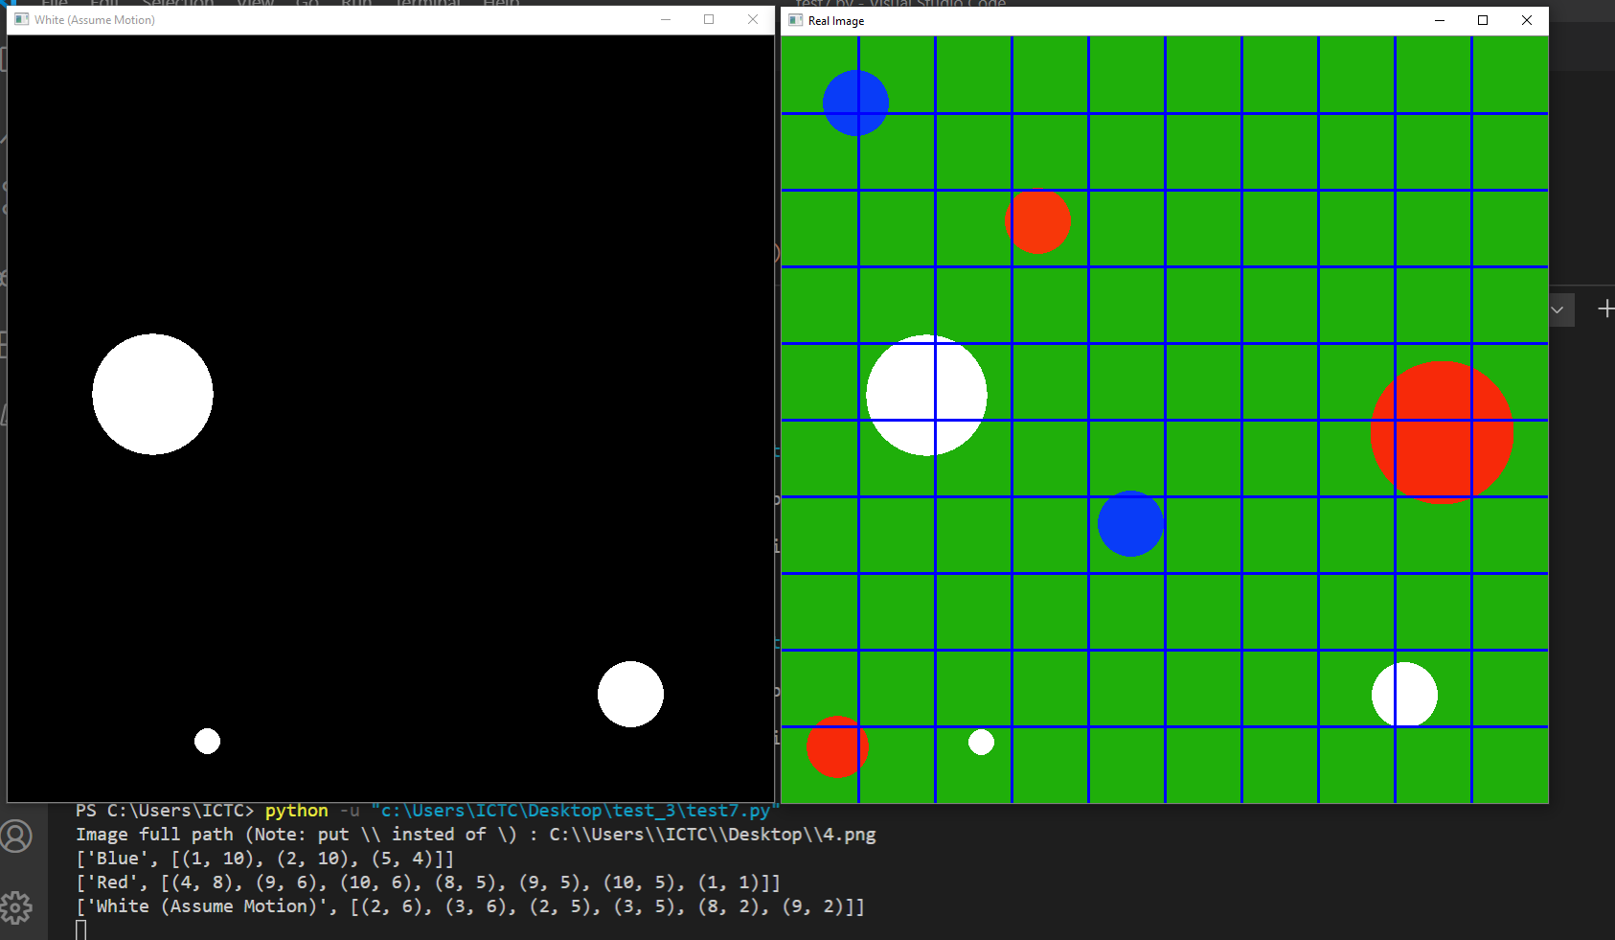
Actual Results
Motion detection white color

Slide 16
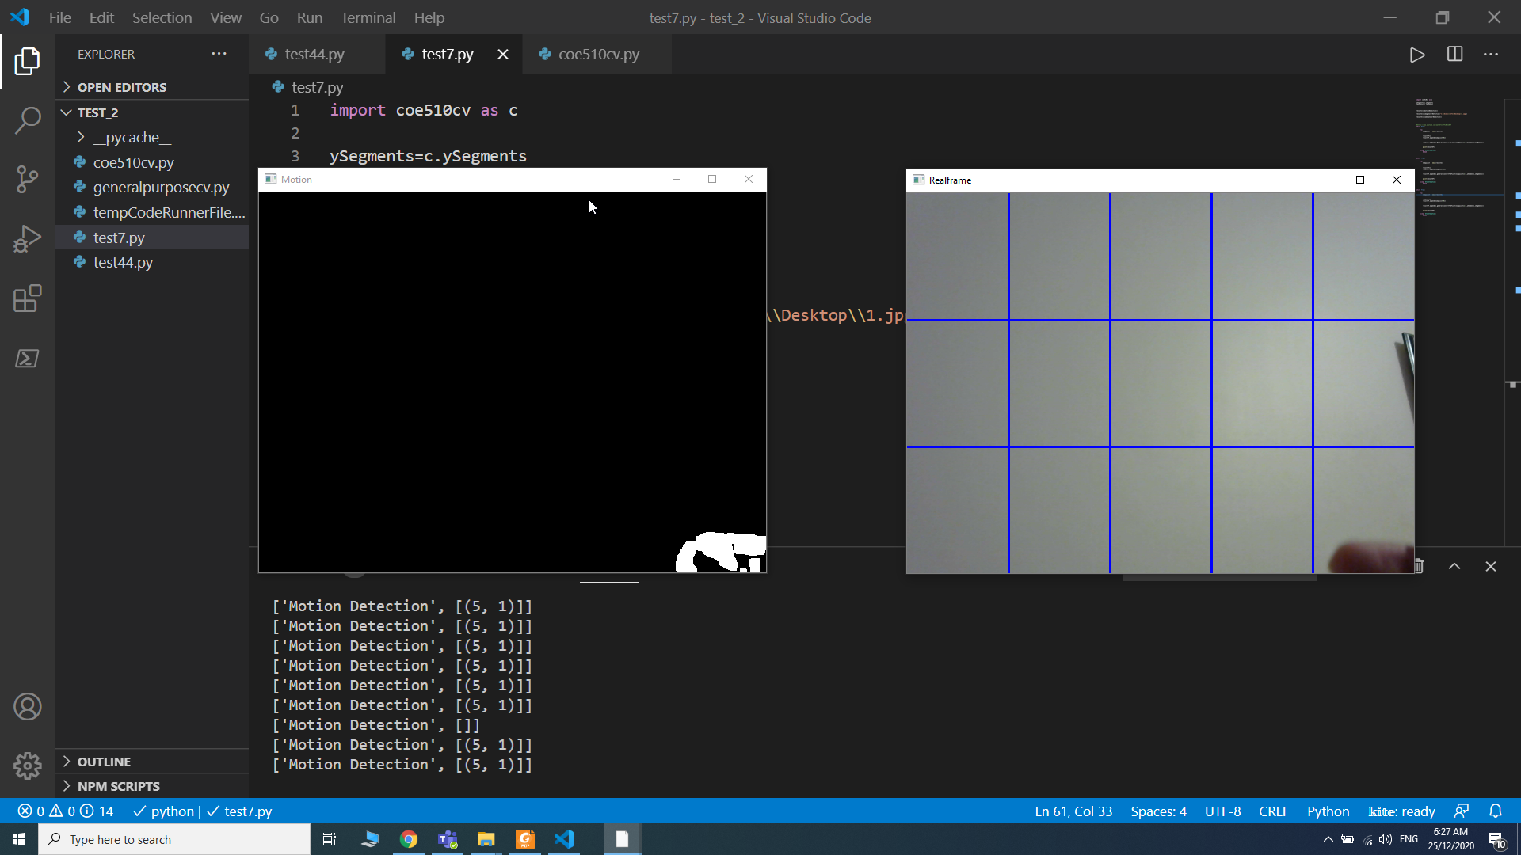
Actual Results
Motion detection Snapshot

Slide 17
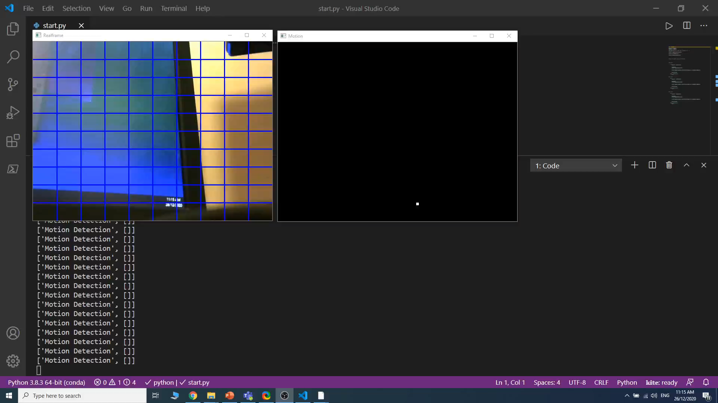
Actual Results
Motion detection video

Slide 18
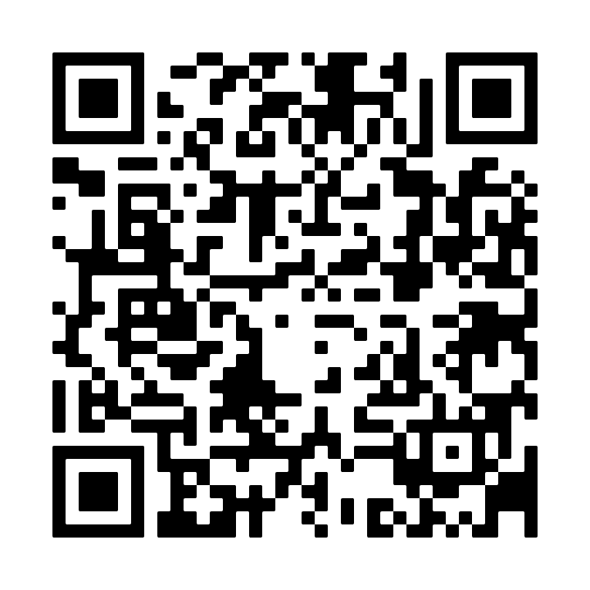
EXE File
File Name: COE_510_openCV.exe
File size: 242 MB
Notes:
1-This file works even if you don’t have python on your computer
2-Usually you will need to deactivate the antivirus if you want to use this file
URL:
https://drive.google.com/drive/folders/1SHTNAtZzVMG6yjDRK-7k1pYQNmsuU9S7?usp=sharing

Slide 19
ROS Nodes
For Video Detection
For Image Detection
Publishers
blue_publisher.py
motion_publisher.py
red_publisher.py
Subscribers:
blue_subscriber.py
motion_subscriber.py
red_subscriber.py
Servers:
blue_server.py
motion_server.py
red_server.py
Clients:
blue_client.py
motion_client.py
red_client.py

Slide 20
Demo

Slide 21
Conclusion and Future work
In this project we introduce a framework for simulating UAV-UGV integrated system.
We used state-of-the-art tools to implement the simulation.
For the future work:
Investigating UAV deployment and navigation algorithms
Model crowd movement

Slide 22
References
[1] Khaleghi, A. M., Xu, D., Wang, Z., Li, M., Lobos, A., Liu, J., & Son, Y. J. (2013). A DDDAMS-based planning and control framework for surveillance and crowd control via UAVs and UGVs. Expert Systems with Applications, 40(18), 7168-7183.
[2] Minaeian, S., Liu, J., & Son, Y. J. (2015). Crowd detection and localization using a team of cooperative UAV/UGVs. In IIE Annual Conference. Proceedings (p. 595). Institute of Industrial and Systems Engineers (IISE).
[3] Motlagh, N. H., Bagaa, M., & Taleb, T. (2017). UAV-based IoT platform: A crowd surveillance use case. IEEE Communications Magazine, 55(2), 128-134.
[4] Zhou, Z., Feng, J., Gu, B., Ai, B., Mumtaz, S., Rodriguez, J., & Guizani, M. (2018). When mobile crowd sensing meets UAV: Energy-efficient task assignment and route planning. IEEE Transactions on Communications, 66(11), 5526-5538.
[5] de Moraes, R. S., & de Freitas, E. P. (2019). Multi-UAV based crowd monitoring system. IEEE Transactions on Aerospace and Electronic Systems, 56(2), 1332-1345.

Slide 23
References
[6] Chriki, A., Touati, H., Snoussi, H., & Kamoun, F. (2019, June). UAV-GCS Centralized Data-Oriented Communication Architecture for Crowd Surveillance Applications. In 2019 15th International Wireless Communications & Mobile Computing Conference (IWCMC) (pp. 2064-2069). IEEE.

Slide 24



